Slide 1

DATABASES AND APPLICATIONS
SUBJECT CODE : UQ23CA653A
Samyukta D Kumta
Computer Applications

Slide 2
DATABASES AND APPLICATIONS
UNIT-IV- Database Model-Object Oriented Model
Object Oriented Model
We have often come across the term 'Object-Oriented Programming' while learning C++, Java, or Python language. The foundation of any object-oriented programming language is based on the concept of objects and classes. This enables the user to achieve abstraction, inheritance, polymorphism, and encapsulation. A similar concept is used in the Object Oriented Model in DBMS.

Slide 3
DATABASES AND APPLICATIONS
UNIT-IV- Database Model-Object Oriented Model
Object Oriented Model
The Object-Oriented Model in DBMS or OODM is the data model where data is stored in the form of objects. This model is used to represent real-world entities. The data and data relationship is stored together in a single entity known as an object in the Object Oriented Model.

Slide 4
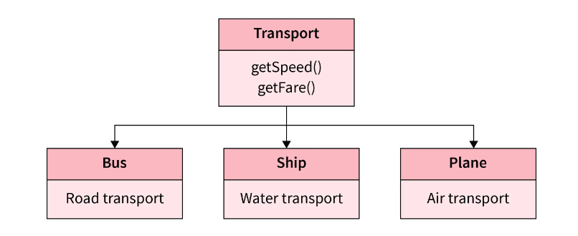
DATABASES AND APPLICATIONS
UNIT-IV- Database Model-Object Oriented Model
Example:1
Transport, Bus, Ship, and Plane are objects.
Bus has Road Transport as the attribute.
Ship has Water Transport as the attribute.
Plane has Air Transport as the attribute.
The Transport object` is the base object and the Bus, Ship, and Plane objects derive from it.

Slide 5
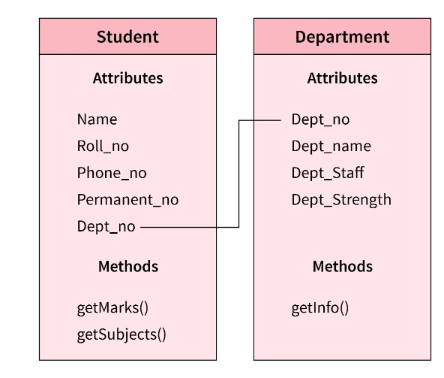
DATABASES AND APPLICATIONS
UNIT-IV- Database Model-Object Oriented Model
Example 2
Student and Department are two different objects.
Each one of them has its attributes and methods.
They are linked by a common attribute Dept_no which establishes a relationship between objects.

Slide 6
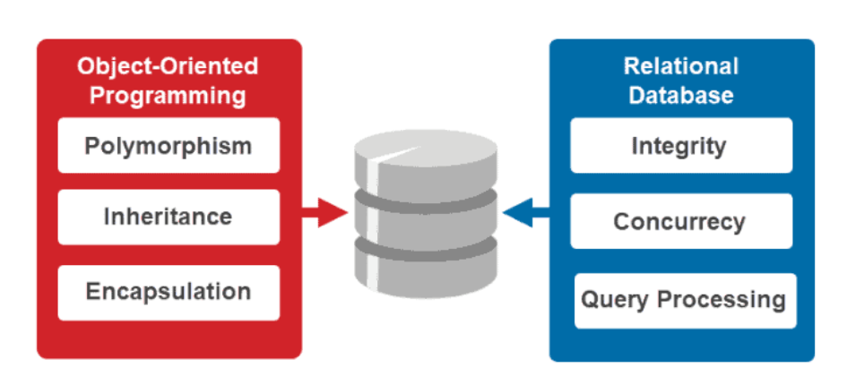
DATABASES AND APPLICATIONS
UNIT-IV- Database Model-Object Oriented Model
Object Oriented and Relational Database Model

Slide 7
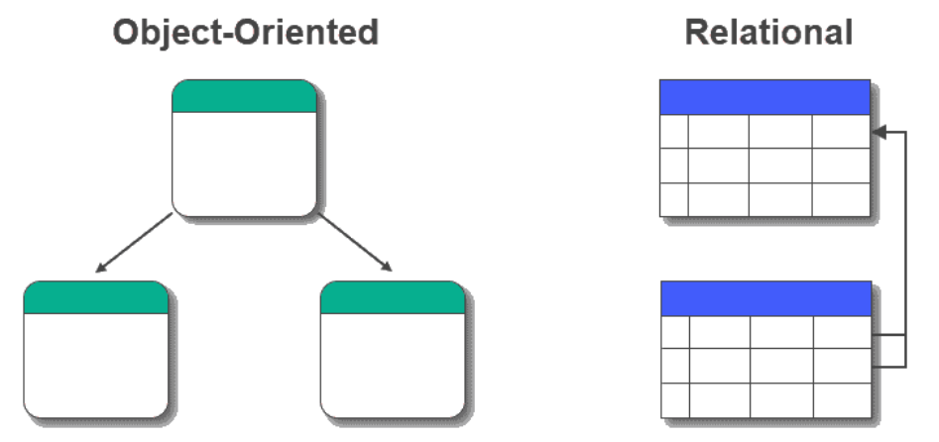
DATABASES AND APPLICATIONS
UNIT-IV- Database Model-Object Oriented Model
Object Oriented and Relational Database Model

Slide 8
DATABASES AND APPLICATIONS
UNIT-IV- Database Model-Object Oriented Model
Object Oriented Database Model
GemStone/S : GemStone/S is an object database system based on Smalltalk an object-oriented programming language influenced by Java.
ObjectDB: ObjectDB is a NoSQL object database for the Java programming languag
ObjectDatabase++ : ObjectDatabase++ is a real-time embeddable object database designed for server-side applications.
Objectivity/DB : Objectivity/DB utilizes the power of objects and satisfies the complex requirements within Big Data
ObjectStore :ObjectStore integrates with C++ or Java and provides memory persistency to improve the performance of application logic.
Versant : Versant provides primary transparent object persistence from C++, Java, and .NET. However, there is also support for Smalltalk and Python.

Slide 9
DATABASES AND APPLICATIONS
UNIT-IV- Database Model-Object Oriented Model
Write the advantages and disadvantages of Object Oriented Database Model.
What are the strength and weakness of Relational database over Object oriented database model.

Slide 10

THANK YOU
Samyukta D Kumta
Department of Computer Applications
samyuktad@pes.edu

